Slide 1
This Photo by Unknown Author is licensed under CC BY

Slide 2
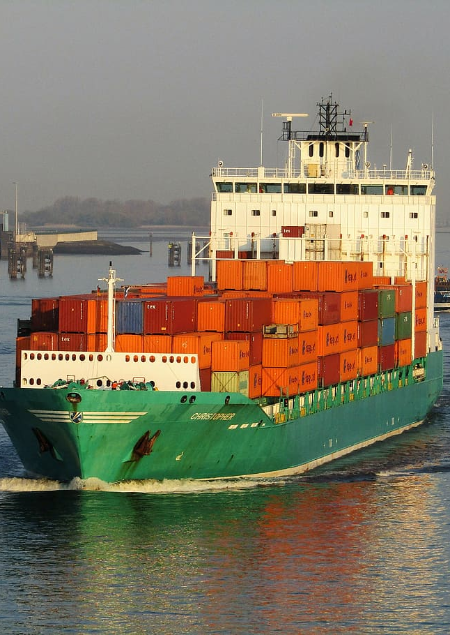
About us
North Star Cargo is a Mumbai-based freight forwarding business that provides reliable and cost-effective shipping solutions for businesses of all sizes. Our team of experienced professionals is dedicated to delivering exceptional customer service and ensuring timely and safe delivery of your cargo.​
We understand the complexities of cargo transportation and are committed to providing customized and efficient solutions that meet your specific needs. With our extensive network of carriers and partners, we have the flexibility to handle your cargo with care and precision, no matter the size or destination.

Slide 3
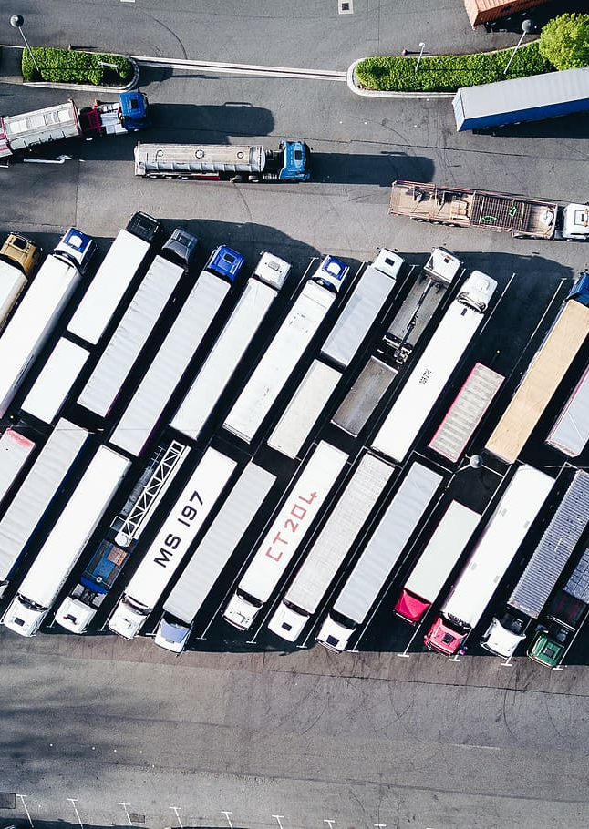
Company overview
Our Mission
To empower clients through innovative and tailor made solutions, fostering a culture of collaboration, integrity, and continuous improvement. We are dedicated to delivering high-quality logistical services that enhance the lives of our customers, while maintaining a commitment to social responsibility and environmental sustainability.
Our Vision
Our vision is to be a global leader in Logistics, creating positive change and value for our clients and partners.

Slide 4
services
We provide efficient freight forwarding services to meet your cargo transportation needs.

Slide 5
services
Contract Logistics: We deliver end-to-end supply chain solutions encompassing design and engineering, procurement and assessment, as well as integrated 4PL services for seamless management of third-party logistics providers.
Air Freight: We provide Sea+Air service, cargo insurance, Special cargo services, air cargo bookings, air charter services to name a few.
Road & Rail Freight: We offer specialized capabilities for transporting high-value goods, heavy and bulky items, two-wheelers, and Out-of-Gauge shipments.
Ocean Freight: We provide project cargo services to transport your heavy and oversized cargo. Our Services include all :From Full Container Load (FCL) and Less-than-Container Load (LCL) shipments to ocean cargo management.
Custom Clearance: We provide customs clearance services to ensure that your cargo complies with all the necessary regulations and procedures, be it import, export or in-transit declarations.
Project Logistics: Leveraging our team of project logistics specialists alongside our extensive global network of connections and resources, we excel in renewable energy, industrial, power, etc.

Slide 6
industries
With our dedicated approach, we take the worry out of shipping & let you focus on your business.

Slide 7
industries
Fashion: Our dedicated team works closely with clients to create efficient and cost-effective shipping strategies that encompass every aspect of sea freight, from consolidation and container management to documentation and customs clearance.
Electronics: We specialize in ensuring the swift transportation of medical-technical products, smartphones, integrated circuit cards and electronic components. We provide local and transport solutions like safety storage, E-commerce, repair, special, spare part & reverse logistics.
Pharma: We specialize in providing seamless cold chain services for the transportation and storage of pharmaceutical products, ensuring uninterrupted temperature control within the range of -70°C to +30°C.

Slide 8
industries
Medical & Healthcare: Our dedicated team, experienced in Biopharma, Medical Devices, Diagnostics & Labs, Hospitals, and Home Care, seamlessly designs both global and local solutions tailored to meet the needs.
Automotive: We provide comprehensive support for every aspect of your automotive supply chain, spanning from inbound and production logistics to outbound, aftermarket, and reverse logistics. .
Food & Beverages: We provide personalized consultation for foodstuffs logistics, crafting door-to-door solutions, handling chilled cargo between 0°C and 4°C. Also, we offer comprehensive cold chain logistics solutions for sea, air, and road transport, encompassing cold storage facilities.

Slide 9
industries
FMCG: We deliver proficient and economical logistics services tailored to the FMCG industry, ensuring rapid movement of high-volume goods and efficient management of manufacturers and suppliers throughout the supply chain.
Wines & Beer: We offer customers extensive logistics solutions for dutiable goods, including import and export licenses specifically for beers, wines and spirits to facilitate the lodging of import and export declarations.
Aerospace: For aerospace logistics, we provide: AOG (Aircraft on Ground) support, Comprehensive air charter services for both full and partial shipments, Chartering of ocean vessels, Manufacturing assistance.
This Photo by Unknown Author is licensed under CC BY-SA-NC

Slide 10
Our Offices
Mumbai
Pune
New Delhi
Hyderabad
Chennai
Ahemdabad
Mundra
Bengaluru
Coimbatore
Jaipur
Kolkata
Vishakhapatnam
Tuticorin

Slide 11
Contact us
Address: 6, Adarsh Industrial Estate, Sahar Road, Chakala, Andheri (East), Mumbai 400099
+91 9820332545
www.northstarcargo.in
info@northstarcargo.com

